Slide 1
ENG 346
Data Structures and Algorithms for Artificial Intelligence
Matrix Operations and Numpy
Dr. Mehmet PEKMEZCİ
mpekmezci@gtu.edu.tr
https://github.com/mehmetpekmezci/GTU-ENG-346
ENG-346 Teams code is 0uv7jlm

Slide 2
Codes
https://github.com/mehmetpekmezci/GTU-ENG-346/tree/main/matrix-numpy-codes

Slide 3
Matrices
Matrices can be used to store data
  Image data (nxm) matrix
  Sound data (nx1) matrix
  Any Log data (nxm) matrix,
    e.g. : log of humidity, temperature, … values in a room
  Geometric data
Matrices can be used for Linear Transformations (Linear Function)
  Rotation
  Translation
  Stretching

Slide 4

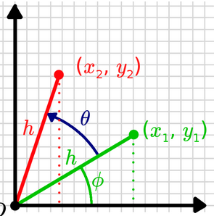
Matrices – Geometric Meaning
Rotation
NOTE: 3D rotation matrix is a 3x3 matrix, not a 2x2x2 tensor
Example :
y
1
√3
cos(π/6) -sin(π/6)
sin(π/6) cos(π/6)
1
√3
√3
1
√3
30⁰
import numpy as np
theta = np.radians(30)
c, s = np.cos(theta), np.sin(theta)
R = np.array(((c, -s), (s, c)))
green_vector=np.array([np.sqrt(3),1])
print(green_vector)
red_vector=np.dot(R,green_vector)
print(red_vector)
1
x
1
√3
https://articulatedrobotics.xyz/tutorials/coordinate-transforms/rotation-matrices-2d/

Slide 5
Multiplication of Matrices
Example : 4x4 matrix A=
We can multiply A and B If A(N,M) . B(M,K)
A(N,M). B(M,K) = C(N,K)
b11 | b12 | b13 | b14
b21 | b22 | b23 | b24
b31 | b32 | b33 | b34
b41 | b42 | b43 | b44
A.B =
+
+
+
a11 | a12 | a13 | a14
a21 | a22 | a23 | a24
a31 | a32 | a33 | a34
a41 | a42 | a43 | a44
a11.b12+ a12.b22+a13.b32+a14.b42
a11.b11+ a12.b21+a13.b31+a14.b41

Slide 6
Matrix Example
Example :
x + 2y = 4
3x - 4y = 5
1 2
3 -4
x
y
4
5
A . X = B
x
y
+
x+2y
3x-4y
4
5
x + 2y = 4
3x - 4y = 5
1 2
3 -4

Slide 7
Determinants and Inverse of a Matrix
Example : 4x4 matrix A=
det(A)=|A| = a . det ( ) - b . det ( )
+ c . det ( ) - d . det( )
e | g | h
i | k | l
m | o | p
a | b | c | d
e | f | g | h
i | j | k | l
m | n | o | p
Minor of element b is det(M12), M12 =
Cofactor(A) is a matrix composed of Cij .
Cij = (-1)^{i+j} det(Mij)
 | f | g | h
 | j | k | l
 | n | o | p
e |  | g | h
i |  | k | l
m |  | o | p
C11 | C12 | C13 | C14
C21 | C22 | C23 | C24
C31 | C32 | C33 | C34
C41 | C42 | C43 | C44
e | f |  | h
i | j |  | l
m | n |  | p
e | f | g
i | j | k
m | n | o
Inverse of A
A⁻¹ = 1/det(A). (Cofactor(A))^{T}
NO INVERSE
if det(A)=0 or
matrix is not square

Slide 8
Transpose and Inverse Properties
A . A⁻¹ = A⁻¹ . A = I
(A⁻¹)⁻¹ = A
(A^{T})^{T} = A
(A^{T})⁻¹ = (A⁻¹)^{T}
(AB)^{T} = B^{T} . A^{T}
(A+B)^{T} = A^{T} + B^{T}
(AB)⁻¹ = B⁻¹ . A⁻¹
(k.A)⁻¹ = 1/k . A⁻¹
(k.A)^{T} = k . A^{T}
det(A^{T}) = det(A)
det(A⁻¹) = 1/det(A)
det(A.B)=det(A).det(B)

Slide 9
Tensors (Multilinear Map)
1
3
Vectors = 1st order Tensor (1D arrays)
Matrices = 2nd order Tensor (2D arrays)
3rd order Tensor , is a stack of matrices ( 3D arrays )
Tensor may have n order.
1 2 3
4 5 6
7 8 9
3x3 matrix
Represented as 2D array data structure.
1 2
3 4
1 2
3 4
1 2
3 4
1 2
3 4
2 x 2 x 3 Tensor (I ,j, k indices)

Slide 10
Matrix Operations
Matrix/Tensor Construction
Dimensions (Shape) and reshaping, array slicing, masking.
Matrix Summation
Transpose of the Matrix
Matrix Multiplication
Inverse of the Matrix
Stacking (Vertical, Horizontal, Depth)
Splitting (Vertical, Horizontal)
Distances ( Mean Squared Error, Mean Absolute Error, Cosine Similarity)
NOT COVERED : Eigenvalues, Eigenvectors, SVD , Tensor Dot

Slide 11
Matrix/Tensor Construction
import numpy as np
a = np.array( [ [1, 2] , [3, 4] ] )
print(a)
1 2
3 4
10 10
10 10
np.full((2, 2), 10,dtype=int)
# 2 rows, 2 columns
1 0
0 1
number_of_rows=2
np.identity(number_of_rows,dtype=int)
0.0 0.0
0.0 0.0
np.zeros(2)
# default dtype=float
1.0 0.0
0.0 1.0
number_of_rows=2
np.identity(number_of_rows,dtype=float)

Slide 12
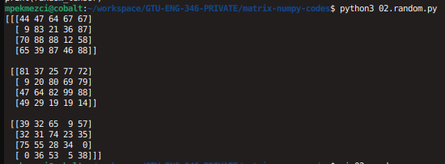
Matrix/Tensor Construction
import numpy as np
np.random.seed(0) # seed for reproducibility
random_tensor = np.random.randint(100, size=(3, 4, 5))
print(random_tensor)

Slide 13
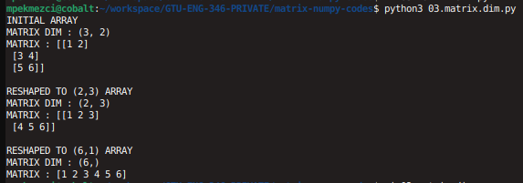
Matrix Dimensions
import numpy as np
print("INITIAL ARRAY")
a = np.array( [ [1, 2] , [3, 4] , [5,6] ] )
print(f"MATRIX DIM : {a.shape}")
print(f"MATRIX : {a}")
print("\nRESHAPED TO (2,3) ARRAY")
b=a.reshape((2,3))
print(f"MATRIX DIM : {b.shape}")
print(f"MATRIX : {b}")
print("\nRESHAPED TO (6,1) ARRAY")
c=a.reshape((6,))
print(f"MATRIX DIM : {c.shape}")
print(f"MATRIX : {c}")
1 2
3 4
5 6

Slide 14
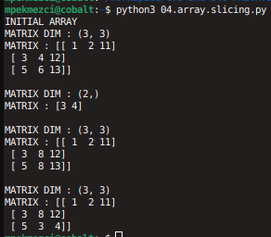
Array Slicing
import numpy as np
print("INITIAL ARRAY")
a = np.array( [ [1, 2,11] , [3, 4,12] , [5,6,13] ] )
print(f"MATRIX DIM : {a.shape}")
print(f"MATRIX : {a}")
b=np.copy(a[1,:2])
print(f"\nMATRIX DIM : {b.shape}")
print(f"MATRIX : {b}")
a[1:,1]=8
print(f"\nMATRIX DIM : {a.shape}")
print(f"MATRIX : {a}")
a[2:,1:]=b
print(f"\nMATRIX DIM : {a.shape}")
print(f"MATRIX : {a}")

Slide 15
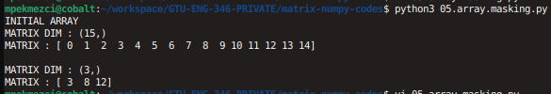
Array Masking
import numpy as np
print("INITIAL ARRAY")
a = np.arange(15)
print(f"MATRIX DIM : {a.shape}")
print(f"MATRIX : {a}")
wanted_indices=[3,8,12]
b=np.copy(a[wanted_indices])
print(f"\nMATRIX DIM : {b.shape}")
print(f"MATRIX : {b}")

Slide 16
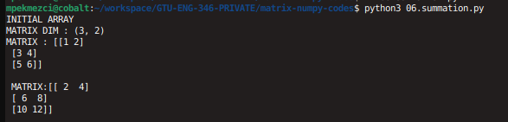
Matrix Summation
import numpy as np
print("INITIAL ARRAY")
a = np.array( [ [1, 2] , [3, 4] , [5,6] ] )
print(f"MATRIX DIM : {a.shape}")
print(f"MATRIX : {a}")
b=a+a
print(f"\n MATRIX:{b} \n")
1 2
3 4
5 6

Slide 17
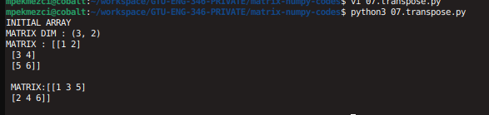
Matrix Transpose
import numpy as np
print("INITIAL ARRAY")
a = np.array( [ [1, 2] , [3, 4] , [5,6] ] )
print(f"MATRIX DIM : {a.shape}")
print(f"MATRIX : {a}")
b=a.T
print(f"\n MATRIX:{b} \n")
1 2
3 4
5 6

Slide 18
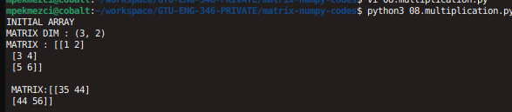
Matrix Multiplication
import numpy as np
print("INITIAL ARRAY")
a = np.array( [ [1, 2] , [3, 4] , [5,6] ] )
print(f"MATRIX DIM : {a.shape}")
print(f"MATRIX : {a}")
b=np.matmul(a.T , a)
print(f"\n MATRIX:{b} \n")
1 2
3 4
5 6

Slide 19
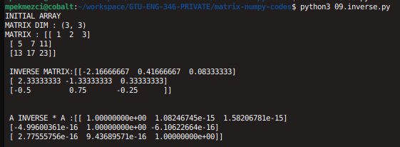
Matrix Inverse
import numpy as np
print("INITIAL ARRAY")
a = np.array( [ [1,2,3] , [5,7,11] , [13,17,23] ] )
print(f"MATRIX DIM : {a.shape}")
print(f"MATRIX : {a}")
b=np.linalg.inv(a)
print(f"\n INVERSE MATRIX:{b} \n")
c=np.matmul(b,a)
print(f"\n A INVERSE * A :{c} \n")
1 2 3
5 7 11
13 17 23
Very close to 0

Slide 20
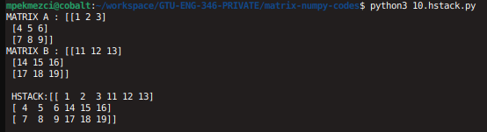
Horizontal Stacking
import numpy as np
a = np.array( [ [1, 2,3] , [4, 5, 6 ] , [7,8,9] ] )
print(f"MATRIX A : {a}")
b = np.array( [ [11, 12,13] , [14, 15, 16 ] , [17,18,19] ] )
print(f"MATRIX B : {b}")
c=np.hstack((a,b))
print(f"\n HSTACK:{c} \n")
1 2 3
4 5 6
7 8 9
11 12 13
14 15 16
17 18 19

Slide 21
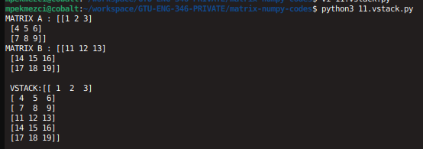
Vertical Stacking
import numpy as np
a = np.array( [ [1, 2,3] , [4, 5, 6 ] , [7,8,9] ] )
print(f"MATRIX A : {a}")
b = np.array( [ [11, 12,13] , [14, 15, 16 ] , [17,18,19] ] )
print(f"MATRIX B : {b}")
c=np.vstack((a,b))
print(f"\n VSTACK:{c} \n")
1 2 3
4 5 6
7 8 9
11 12 13
14 15 16
17 18 19

Slide 22
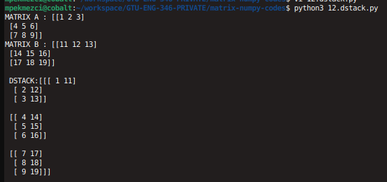
Depth Stacking
import numpy as np
a = np.array( [ [1, 2,3] , [4, 5, 6 ] , [7,8,9] ] )
print(f"MATRIX A : {a}")
b = np.array( [ [11, 12,13] , [14, 15, 16 ] , [17,18,19] ] )
print(f"MATRIX B : {b}")
c=np.dstack((a,b))
print(f"\n DSTACK:{c} \n")
1 2 3
4 5 6
7 8 9
11 12 13
14 15 16
17 18 19

Slide 23
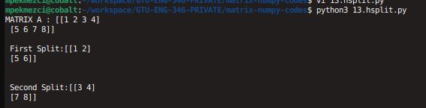
Horizontal Splitting
import numpy as np
a = np.array( [ [1, 2,3,4] , [5, 6, 7,8 ] ] )
print(f"MATRIX A : {a}")
b,c=np.hsplit(a,2)
print(f"\n First Split:{b} \n")
print(f"\n Second Split:{c} \n")
1 2 3 4
5 6 7 8

Slide 24
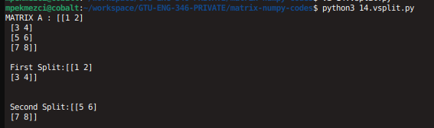
Vertical Splitting
import numpy as np
a = np.array( [ [1, 2] ,[3,4] , [5, 6], [7,8 ] ] )
print(f"MATRIX A : {a}")
b,c=np.vsplit(a,2)
print(f"\n First Split:{b} \n")
print(f"\n Second Split:{c} \n")
1 2
3 4
5 6
7 8

Slide 25
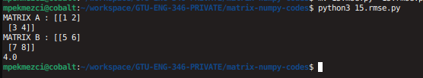
Distance – Root Mean Squared Error – Euclidean Distance
import numpy as np
a = np.array( [ [1, 2] ,[3,4] ] )
print(f"MATRIX A : {a}")
b = np.array( [ [5, 6] ,[7,8] ] )
print(f"MATRIX B : {b}")
rmse = np.sqrt((np.square(a - b)).mean())
print(rmse)
5 7
6 8
1 2
3 4
A=
B=
N=2, M=2 in this case

Slide 26

Distance – Mean Absolute Error
import numpy as np
a = np.array( [ [1, 2] ,[3,4] ] )
print(f"MATRIX A : {a}")
b = np.array( [ [5, 6] ,[7,8] ] )
print(f"MATRIX B : {b}")
mae=np.absolute(a-b).mean()
print(mae)
5 7
6 8
1 2
3 4
A=
B=
N=2, M=2 in this case

Slide 27
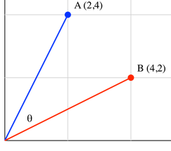
Distance – Cosine Distance
import numpy as np
from numpy.linalg import norm
A = np.array([2, 4])
B = np.array([4, 2])
# compute cosine similarity
cosine = np.dot(A, B) / (norm(A) * norm(B))
print("Cosine Distance:", 1-cosine)
2
4
4
2
A=
B=

Slide 28
Distance – Cosine Distance - Matrix
import numpy as np
from numpy.linalg import norm
A = np.array([[1, 2, 2], [3, 2, 2], [-2, 1, -3]])
B = np.array([[4, 2, 4], [2, -2, 5], [3, 4, -4]])
cosine = np.sum(A * B, axis=1) / (norm(A, axis=1) * norm(B, axis=1))
print("Cosine Similarity:", cosine)

